Slide 1

Java scrips basics
Week 4

Slide 2
Variable
The variable is a container we create that holds whatever data we put into it.
In JavaScript, a variable is created by typing in var and then the variable name.
That name can be anything, as long as it's written with letters, numbers, underscores, and a dollar-sign, and has no spaces.

Slide 3
var a
var b
var a=5
var b=3
Insert values for a and b
5
3

Slide 4

JavaScript is case-sensitive.
So var lower-case a and var upper-case A are two different variables.

Slide 5

Data Types
Numeric
String
Boolean
Null
undefined

Slide 6
Regular numbers and integers
var something =1;
var pi = 3.14;
var negNumbers =-1;

Slide 7
String data types (stores strings of letters and symbols)
var today = “Here you can put words and sentences”

Slide 8
Null data
Intentional absence of a value

Slide 9
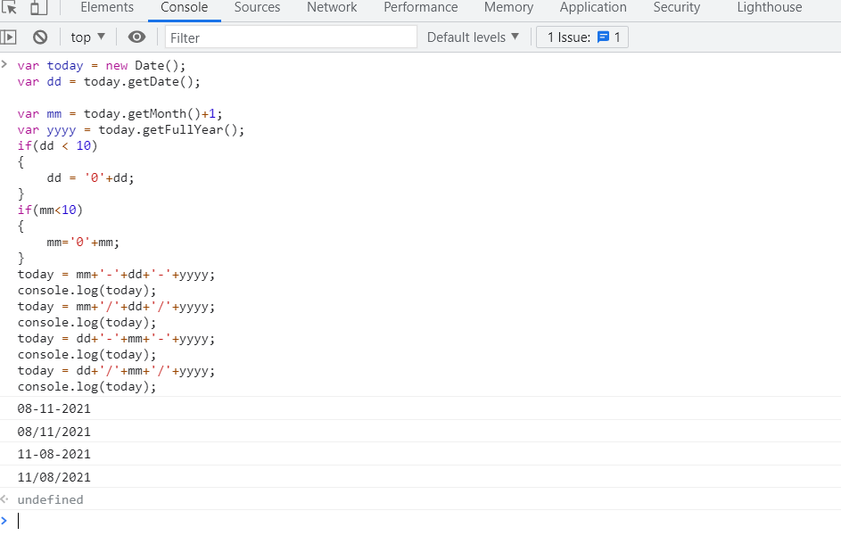
LETS DO JAVASCRIPT BASIC

